Slide 1
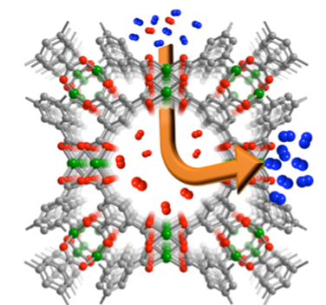
Functional Materials
Hmadeh Group

